Slide 1

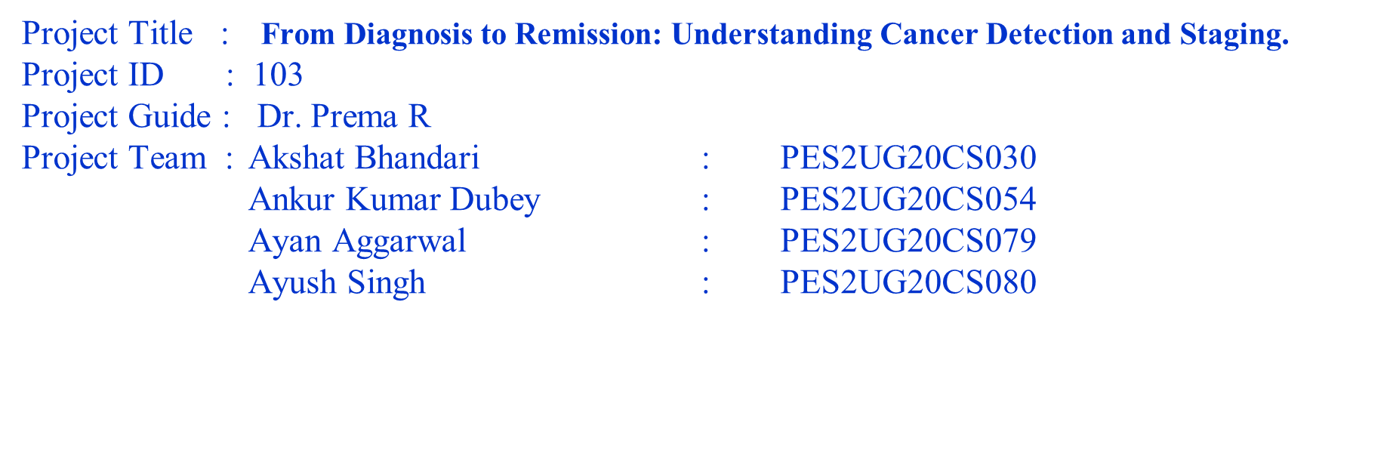
UE20CS390A – Project Phase – 1
End Semester Assessment

Slide 2
Agenda
Introduction and Motivation
Problem Statement
Abstract and Scope
Literature Survey / Existing System
Suggestions from Review – 3
Requirements Specification
Design Approach
Design Constraints, Assumptions & Dependencies
Proposed System / Approach
Architecture
Design Description
Project Progress
References

Slide 3
Introduction and Motivation
Lung cancer is one of the leading causes of death globally, accounting for approximately 1.76 million deaths in 2018 alone. Early detection of lung cancer is critical in improving patient outcomes and reducing mortality rates. However, traditional diagnostic methods for lung cancer, such as biopsy and X-rays, can be invasive, time-consuming, and expensive. As a result, there is a need for a non-invasive and cost-effective method for early detection of lung cancer.
The motivation behind this project is to develop a novel and efficient approach for detecting lung cancer using machine learning and image processing techniques. By utilizing CT images of the lungs and advanced machine learning algorithms, we aim to provide doctors with an accurate and reliable tool for detecting lung cancer at an early stage. The proposed web-based system will allow doctors to quickly upload CT images of the lungs and receive detailed reports on the presence and stage of lung cancer. This project has the potential to improve patient outcomes, reduce healthcare costs, and save lives.

Slide 4
Problem Statement
The problem addressed by this project is the need for a non-invasive and cost-effective method for early detection of lung cancer using CT images of the lungs. Traditional diagnostic methods for lung cancer, such as biopsy and X-rays, can be invasive, time-consuming, and expensive. Moreover, these methods have limitations in terms of accuracy, especially in detecting small nodules. As a result, patients may not receive an accurate diagnosis until the cancer has progressed to advanced stages. This delays the start of the treatment, which reduces the chances of successful treatment outcomes and increases the mortality rate.
The proposed solution is a web-based system that utilizes advanced machine learning algorithms and image processing techniques to accurately detect the presence and stage of lung cancer. The system will allow doctors to quickly upload CT images of the lungs and receive detailed reports on the presence and stage of lung cancer. The system aims to be non-invasive, accurate, and cost-effective compared to traditional diagnostic methods. The proposed solution has the potential to revolutionize the field of lung cancer diagnosis by improving patient outcomes, reducing healthcare costs, and saving lives.

Slide 5
Abstract and Scope
The proposed project aims to develop an accurate, efficient, and automated system that uses machine learning and image processing techniques to detect lung tumors and color-code them based on cancer stage. The system will be accessible via a web-based platform that allows clinicians to upload CT images of the lungs and receive detailed reports on the presence and stage of lung cancer. The project seeks to provide a non-invasive and cost-effective solution for detection and diagnosis of lung cancer, ultimately improving patient outcomes, reducing healthcare costs, and saving lives. The system's accuracy will depend on the quality of the input data and the machine learning algorithms used.

Slide 6
Literature Survey
Paper Details | Objective of paper, Technique Methods
Lung Cancer Detection and Classification using CT Scan Image Processing by Nusraat Nawreen Umma Hany Tahmina Islam Department of Electrical and Electronic Engineering -2022 | Lung cancer detection and classification into benign and malignant cancer using CT scan image processing Image preprocessing steps : Image Resizing Image Smoothening : Median filter with zero padding Image Enhancement : Using MATLAB Tool Dataset : TCIA Converting Preprocessed image into binary using threshold and then detecting edges in binary Features Extraction : (Area, Perimeter,Eccentricity,Compactness,Circularity) Classification : Using SVM
Lung nodules: A comprehensive review on current approach and management by Konstantinos Loverdos, Andreas Fotiadis, Chrysoula Kontogianni, Marianthi Iliopoulou, and Mina Gaga Year:2021 | The paper reviews current knowledge on nodule definition, diagnostic evaluation, and management based on literature data and recent guidelines. This paper discusses about the different types of nodules present in lungs on the basis of size: Small nodules (<5 or 6mm) Intermediate solid nodules (<8 mm) Larger solid nodules (≥8 mm)

Slide 7
Literature Survey
Paper Details | Objective of paper, Technique Methods
Lung cancer prediction and Stage classification in CT Scans Using Convolution Neural Networks -A Deep learning Model by- V.Deepa, P.Mohamed Fathimal IEEE-2022 | Objective: To develop a deep learning model based on Convolutional Neural Networks (CNNs) to predict the presence of lung cancer in CT scans and classify the cancer stage. Technique Methods: The images are trained based on the Dicom data. The dicom format helps in minimizing the loss in the feature. The CNN model is trained on this dataset using a transfer learning approach, where a pre-trained CNN model (VGG16) is used as a starting point and fine-tuned for the specific task of lung cancer classification The proposed model was used to classify lung cancer into four stages (Stage I, Stage II, Stage III, and Stage IV) based on the size and location of the tumor in the CT scans. The performance of the proposed model was evaluated using various metrics such as accuracy, sensitivity, specificity, and area under the receiver operating characteristic curve .
Lung Cancer Prediction using Machine Learning: A Comprehensive Approach by - Syed Saba Raoof, M A. Jabbar ,Syed Aley Fathima IEEE-2020 | Objective: This paper involves a comprehensive approach to developing a machine learning model for predicting lung cancer. Technique Methods: The most relevant features for predicting lung cancer are identified using various feature selection techniques such as correlation analysis, chi-square test, and recursive feature elimination. Various machine learning models such as logistic regression, decision trees, support vector machines, and artificial neural networks are evaluated to select the best performing model. Algorithms used are Convolutional Neural Network, . Fully Convolutional Networks (FCN’s) , Auto-Encoders (AE’s)

Slide 8
Literature Survey
Paper Details | Objective of paper, Technique Methods
Image Acquisition and Pre-processing for Detection of Lung Cancer using Neural Network by B C Kavitha K B Naveen,Dept of ECE, BGS Institute of Technology, Adichunchanagiri University, India -2022 | The study focuses on developing an efficient pre-processing technique for image acquisition and image enhancement, and then using a neural network to classify the images as either cancerous or non-cancerous. The paper proposes a methodology that involves the following steps: Image Acquisition: The images of lungs are obtained using Computed Tomography (CT) scan or X-ray. Pre-processing: using various image enhancement techniques like histogram equalization, contrast stretching, and filtering to preprocess the images Feature Extraction: used texture analysis techniques such as gray-level co-occurrence matrix (GLCM) Classification: convolutional neural network (CNN) which is trained on the extracted features to classify the images.
Proposed methodology for Early Detection of Lung Cancer with low-dose CT Scan using Machine Learning by: Gagan Thakral, Sapna Gambhir Nagender Aneja Department of Computer Engineering, J. C. Bose University of Science and Technology, YMCA, Faridabad, India. School of Digital Science, Universiti Brunei Darussalam, Brunei, Darussalam -2022 | To present a methodology for early detection of lung cancer using low-dose CT (LDCT) scans. There are four stages or components in this proposed system: LDCT Preprocessing: using Wavelet Transform & weiner filter Lung Segmentation using Fuzzy C-Means (FCM) approach. Lung Feature Extraction and selection: employ the CNN approach. Nodule Classification: CNN approach

Slide 9
Literature Survey
Paper Details | Objective of paper, Technique Methods
Multi-Stage Lung Cancer Detection and Prediction Using Multi-class SVM Classifier by Janee Alam, Sabrina Alam, Alamgir Hossan | Lung cancer stage classification using Affected area(Diseased Area/Total area). Dataset :Taken from UCI machine learning database. Converting the Pre-processed image into an Segmented Image using watershed based algorithm to analyse different regions and identify lung lesions (abnormal regions). Features Extraction using GLCM (Gray Level Co-Occurrence Method) . Classification : Using Multi Class SVM .
Isoline Based Image Colorization by Adam Popowicz, Bogdan Smolka | This paper proposes a method for image colorization based on isolines and user-defined color constraints. A method of colorization based on the minimization of color difference between adjacent pixels of similar intensity. Starting with scribbles indicated by an operator, the algorithm minimizes the difference between the color in particular pixel and the weighted average of colors of neighboring pixels. This can be solved using Least Squares Method

Slide 10
Suggestions
Suggestions
Implement a color-coding scheme to assist Medical Professionals/Patients in identifying abnormal/cancerous regions based on cancer stage.
Create a reports section to provide medical professionals with in-depth analysis and insights, such as treatment plans available, specialized hospitals, and life expectancy.
Ensure the website's interface is user-friendly and intuitive, allowing medical professionals to quickly and easily upload and analyze medical images.
Focus on accuracy and reliability in the project's development to provide medical professionals with a valuable tool for early detection and diagnosis of lung cancer.

Slide 11
Requirements Specification
Functional Requirements:
The lung cancer stage detection system using colourization technique should be able to accurately identify the stage of cancer based on the input CT scan image. The following features and functionalities must be included in the system:
The system should be able to preprocess the input CT scan image, which includes image enhancement, noise reduction, and segmentation.
The system should be able to extract features from the preprocessed image such as the size and shape of the tumor, texture, and color variations.
The system should use these extracted features to classify the cancer stage into four categories: Stage I, Stage II, Stage III, and Stage IV.
The system should display the predicted cancer stage to the user, along with a visual representation of the segmented tumor region

Slide 12
Requirements Specification
Hardware Requirements:
For Mac OS: macOS Sierra or higher, M1 chip or higher with integrated graphics, 8GB RAM, 10GB available disk space
For Windows: Windows 10 or higher, 64-bit Processor (Intel i5 or AMD Ryzen 5000 series or higher), 8GB RAM, AMD Radeon Graphics card or better, 10GB available disk space
For Linux: Any Linux distribution supporting Python and graphics libraries, 64-bit Processor (Intel i5 or AMD Ryzen 5000 series or higher), 8GB RAM, AMD Radeon Graphics card or better, 10GB available disk space

Slide 13
Requirements Specification
Non-Functional Requirements:
The lung cancer stage detection system using colourization technique should meet the following non-functional requirements:
The system should be highly accurate in its predictions, with a high level of precision and recall.
The system should be fast and responsive, with minimal latency and processing time, so that it can be used in real-time scenarios.
The system should be easy to use and operate, with a simple and intuitive user interface.
The system should be robust and reliable, with no single point of failure and should be able to handle different types of input images.

Slide 14
Requirements Specification
Software Requirements:
Programming Language: Python 3.8 or higher
IDE: Visual Studio Code 1.53.0 or later, Google Colab version 3.9
Machine Learning Framework: Tensorflow 2.4.1 or later, Scikit-Learn 0.24.2 or later, Keras 2.4.3 or later
Image Processing Library: OpenCV-Python 4.5.1.48 or later
Flask Web Framework: Flask version 1.1.2 or later
Database: SQLite, MySQL, or PostgreSQL
Version Control: Git
Operating System: Windows 10 or higher 64 bit, Mac OS 12.2 or later

Slide 15
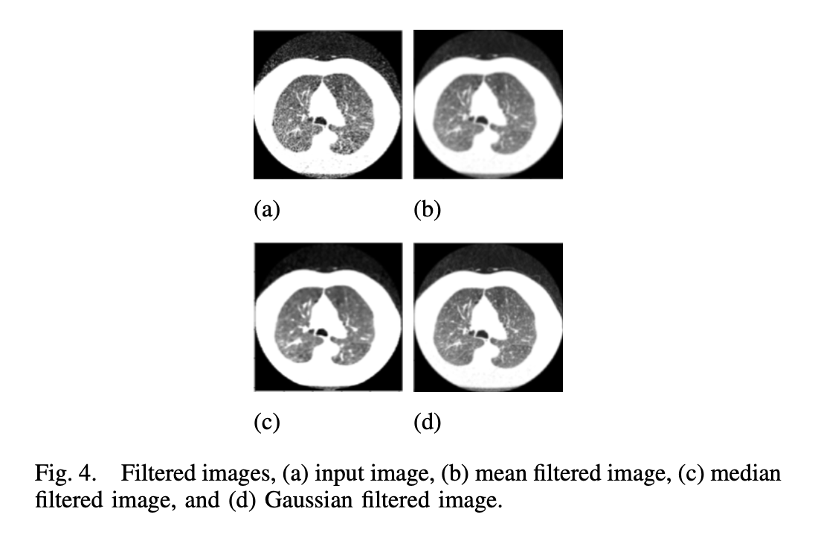
Algorithms Used
Median Filtering
It is a Non Linear Filtering method
It helps in removing noise by Smoothing it .
Salt and pepper/impulse noise can be removed using this filter.
We can retain the edges by applying zero padding
Empty mask is passed and median value is taken.
We can use mean filtering along with it to reduce the contrast of the image.
Reducing the contrast helps in highlighting various features that may be hidden due to high contrast.

Slide 16
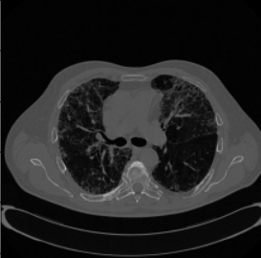
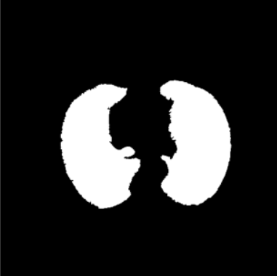
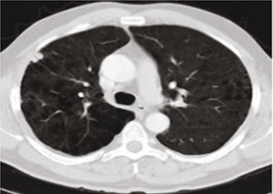
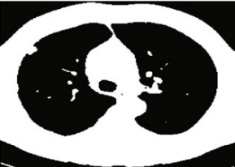

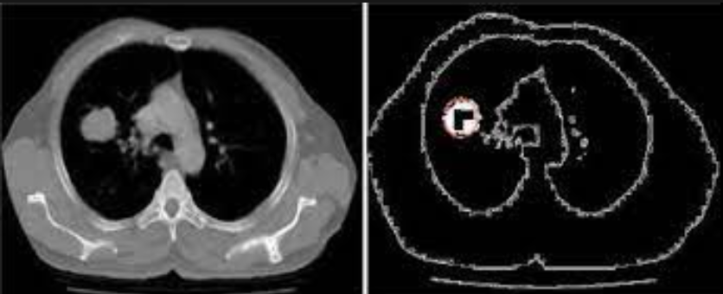
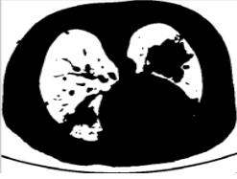
Algorithms Used
Ct-Scan Data - Segmentation
Watershed based Segmentation
2) Otsu method
Normal Ct Image
after using otsu method
original image
after watershed- segmentation
3) Threshold based segmentation
4) Hough tranformation
mean filtered image
Threshold Image
normal ct image
after applying hough
16

Slide 17
Algorithms Used
SVM (Support Vector Machine) is a supervised machine learning method that can be used to classify input data according to a pattern. It is suitable for large datasets and can classify data into two groups. We plan to use SVM to classify cancer as either benign or malignant, which is a binary classification problem. SVM works by finding a hyperplane in an N-dimensional space that distinctly classifies the data points. Our research suggests that SVM performs well in the classification of cancer into malignant or benign.
Convolutional Neural Networks (CNNs) are commonly used in tumor detection tasks as they can learn complex features from medical images effectively. CNNs work by applying convolutional filters to input images to identify and extract relevant features such as edges, textures, and shapes. In tumor detection, CNNs can recognize specific patterns and structures indicative of different stages of tumor growth. They can be trained using large datasets of labeled medical images, allowing them to accurately detect and classify tumors based on their stage.

Slide 18
Design Approach
What is the design approach followed? And Why?
The design approach followed for this project is a combination of image processing and machine learning techniques. The process involves detecting lung nodules from medical images, analyzing the characteristics of the nodules to determine if they are benign or malignant, and classifying the stages of tumor based on nodules size. Finally, colorization techniques are applied to enhance the visibility of the nodules.
This approach is suitable for the project as it leverages the strengths of both image processing and machine learning techniques to provide accurate detection and classification results. Image processing techniques can help to preprocess the medical images, segment lung nodules, and extract features from the nodules for further analysis. Machine learning algorithms, such as deep learning, can be used to learn patterns and features from the nodules to classify them as benign or malignant, and to determine the stages of tumor based on nodules size.

Slide 19
Design Approach
Benefits of this approach and any drawbacks
The benefits of this approach are that it can provide accurate and efficient detection and classification results, which can help clinicians in the early diagnosis of lung cancer. This approach can also reduce the chances of misdiagnosis and unnecessary biopsies. Additionally, colorization techniques can enhance the visibility of the nodules and make them more prominent for better analysis.
However, there are also some potential drawbacks to this approach. One challenge is that the accuracy of the classification results heavily depends on the quality of the medical images and the selection of appropriate features for analysis. Another potential issue is that the model may require a large amount of training data and computational resources to achieve high accuracy.

Slide 20
Design Approach
Alternate design approaches
An alternate design approach could be to use traditional machine learning algorithms, such as decision trees, support vector machines, or random forests, instead of deep learning techniques. This approach can be more interpretable and require less computational resources. However, it may not achieve the same level of accuracy as deep learning techniques, particularly when dealing with complex medical images. Another alternative could be to use a rule-based approach, which can leverage domain-specific knowledge and expert rules to classify lung nodules based on their characteristics. This approach may be more explainable, but it may not be as accurate as machine learning approaches.

Slide 21
Design Constraints, Assumptions & Dependencies
Assumptions:
● Availability of DICOM-formatted CT scan images: The website assumes that CT scan images of the lungs are available in DICOM format, and can be uploaded to the website by users.
● User privacy and data security: The website assumes that user privacy and data security are maintained by implementing appropriate measures such as data encryption, secure storage, and access controls.
● Reliable internet connection: Users are assumed to have access to a reliable internet connection for uploading the CT scan images and accessing the website's services.
● Sufficient computing power: The website assumes that it has sufficient computing power to process and analyze the uploaded CT scan images using deep learning algorithms.

Slide 22
Design Constraints, Assumptions & Dependencies
Constraints:
● Quality of imaging: The accuracy and quality of the images used for detection can be a significant constraint in the diagnosis of lung cancer. Low-quality images can result in false positives and false negatives, leading to incorrect diagnosis and treatment.
● Technical limitations of imaging techniques: Imaging techniques may not be able to detect small tumors or may not provide sufficient detail to accurately determine the stage of cancer.
● Variability of tumor growth: Lung tumors can grow at different rates, making it difficult to accurately determine the stage of cancer at a given time.
● Legal repercussions: Working with medical data may have legal repercussions, such as adhering to data privacy laws or receiving regulatory approval. Legal repercussions or reputational harm may follow failure to adhere to these requirements.

Slide 23
Design Constraints, Assumptions & Dependencies
Dependencies:
● Programming language: We will be using Python as our programming language.
● Machine learning framework: We plan to use TensorFlow as our machine learning framework to build and train our model.
● Image processing libraries: For image processing, we will be using OpenCV and Pillow libraries to preprocess the medical images.
● Data visualization libraries: We will use Matplotlib and Seaborn libraries to visualize our data and model results.
● Web application framework: If we decide to build a web application, we will use either Flask or Django as our web application framework.
● Database: We will use a database to store patient information and medical images. We plan to use either MySQL, PostgreSQL, or MongoDB as our database.
● Cloud computing services: If we decide to deploy our application in the cloud, we may use services such as AWS or GCP.

Slide 24
Design Details
Novelty and Innovativeness
Our project aims to introduce a novel approach to detecting lung cancer from CT scan images by developing a machine learning model that not only identifies the presence of cancer but also determines the stage of the cancer automatically. By colorizing the tumor region based on its stage, we aim to create a system that is easy to use, reliable, and can save time for medical professionals, thereby improving overall patient outcomes.
The novelty of our project lies in its unique and innovative approach to lung cancer detection, which goes beyond traditional methods and provides valuable information that can aid medical professionals in planning appropriate treatment options. By incorporating the colorization of the tumor region based on its stage, we aim to provide an additional visual aid for medical professionals and improve the accuracy of the diagnosis.

Slide 25
Design Details
Maintainability:
The proposed solution is designed to be easily maintainable, with regular updates and improvements made to ensure optimal performance.
Portability:
Like interoperability application should be portable across different platforms and devices.
Legacy to Modernization:
The website should be designed with modern web development standards in mind, allowing it to be easily updated and modernized as new technologies emerge.
Reusability and Application Compatibility:
The website will be designed with reusability in mind, making it easy to integrate into different applications and workflows.

Slide 26
Design Details
Interoperability:
The website should be designed and developed to be compatible with different web browsers and devices, ensuring interoperability across different platforms. We recommend using responsive web design techniques to optimize the website's layout and functionality on different screen sizes and resolutions.
Performance:
The website should be optimized for performance, ensuring that it loads quickly and efficiently. This can be achieved by minimizing the size of images and other media files and optimizing code.
Security:
The proposed solution adheres to standard healthcare security protocols to ensure patient data is protected and confidential.
Reliability:
To make our project more reliable, we can take several steps such as thorough testing, effective bug tracking and fixing, high-quality code, continuous integration, and error monitoring. By implementing these measures, we can ensure that our project performs consistently and accurately under different circumstances and user conditions, helping to build trust and confidence among users, reduce the likelihood of errors, and improve the overall user experience.

Slide 27
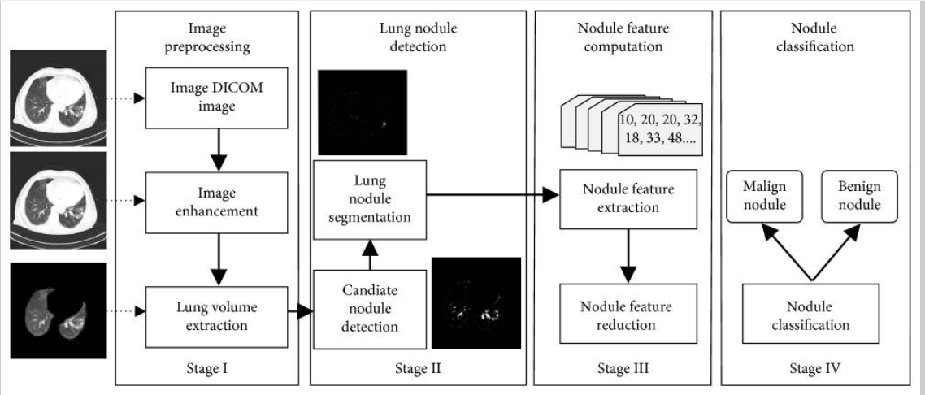
Proposed Methodology / WorkFlow

Slide 28
Proposed Methodology / Approach
There will be several phases in our project which will bring to conclusion:
Phases:
Phase 1
Doctor screening the patient.
Uploading Patient CT Scan with patient details onto the Database using Doctor’s interface.
Phase 2
To make the images more clear , we apply some filters on CT scan like binary filtering .
After obtaining a clear image our model will check whether the cancer is malignant or benign .
If the cancer is benign we can tell that the cancer is non cancerous and and we can build a report for the same.
If the cancer is malignant i.e. cancerous we need to detect the stage of cancer that will be based on the basis of affected area.

Slide 29
Proposed Methodology / Approach
Phase 3
For stage detection we would need to find the nodule size through which we would be able to tell the stage of cancer.
After detecting the area of spread and nodule size , system would assign stage to cancer and will be able to colour the area of spread .
We would assign the colour on basis of stage.
Phase 4
In this phase Report will be created .
Report will consist of components like :
Cancer Type
Stage
Original CT Scan
Colourised CT Scan
3) This report will be uploaded on database and can be accessed by patient or Doctor.

Slide 30
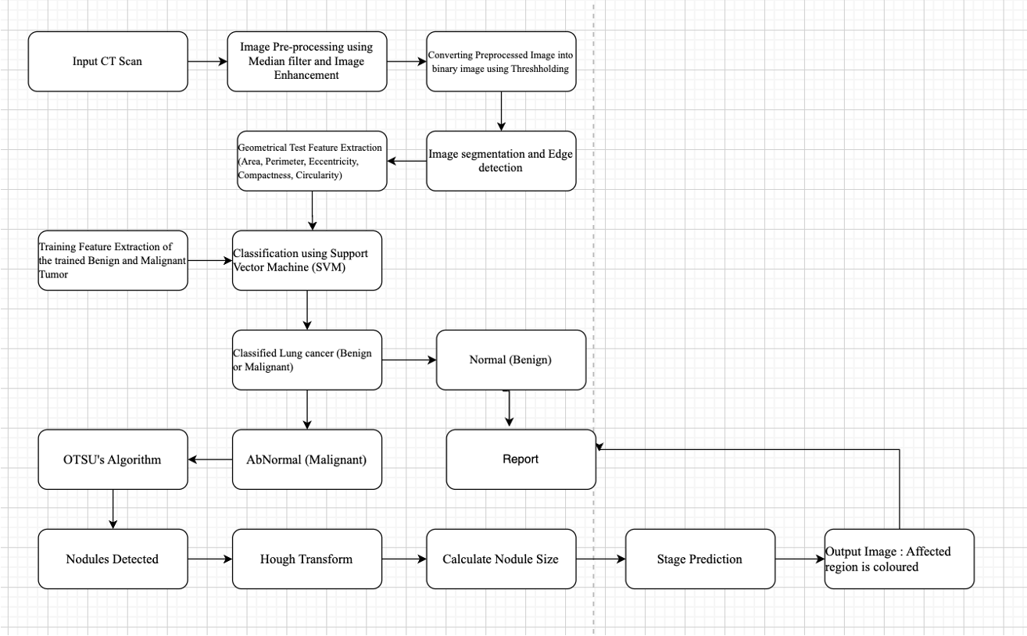
Architecture

Slide 31
Design Description
Master class diagram
ER Diagram
User Interface Diagrams/ Use Case Diagrams
Report Layouts
External Interfaces

Slide 32
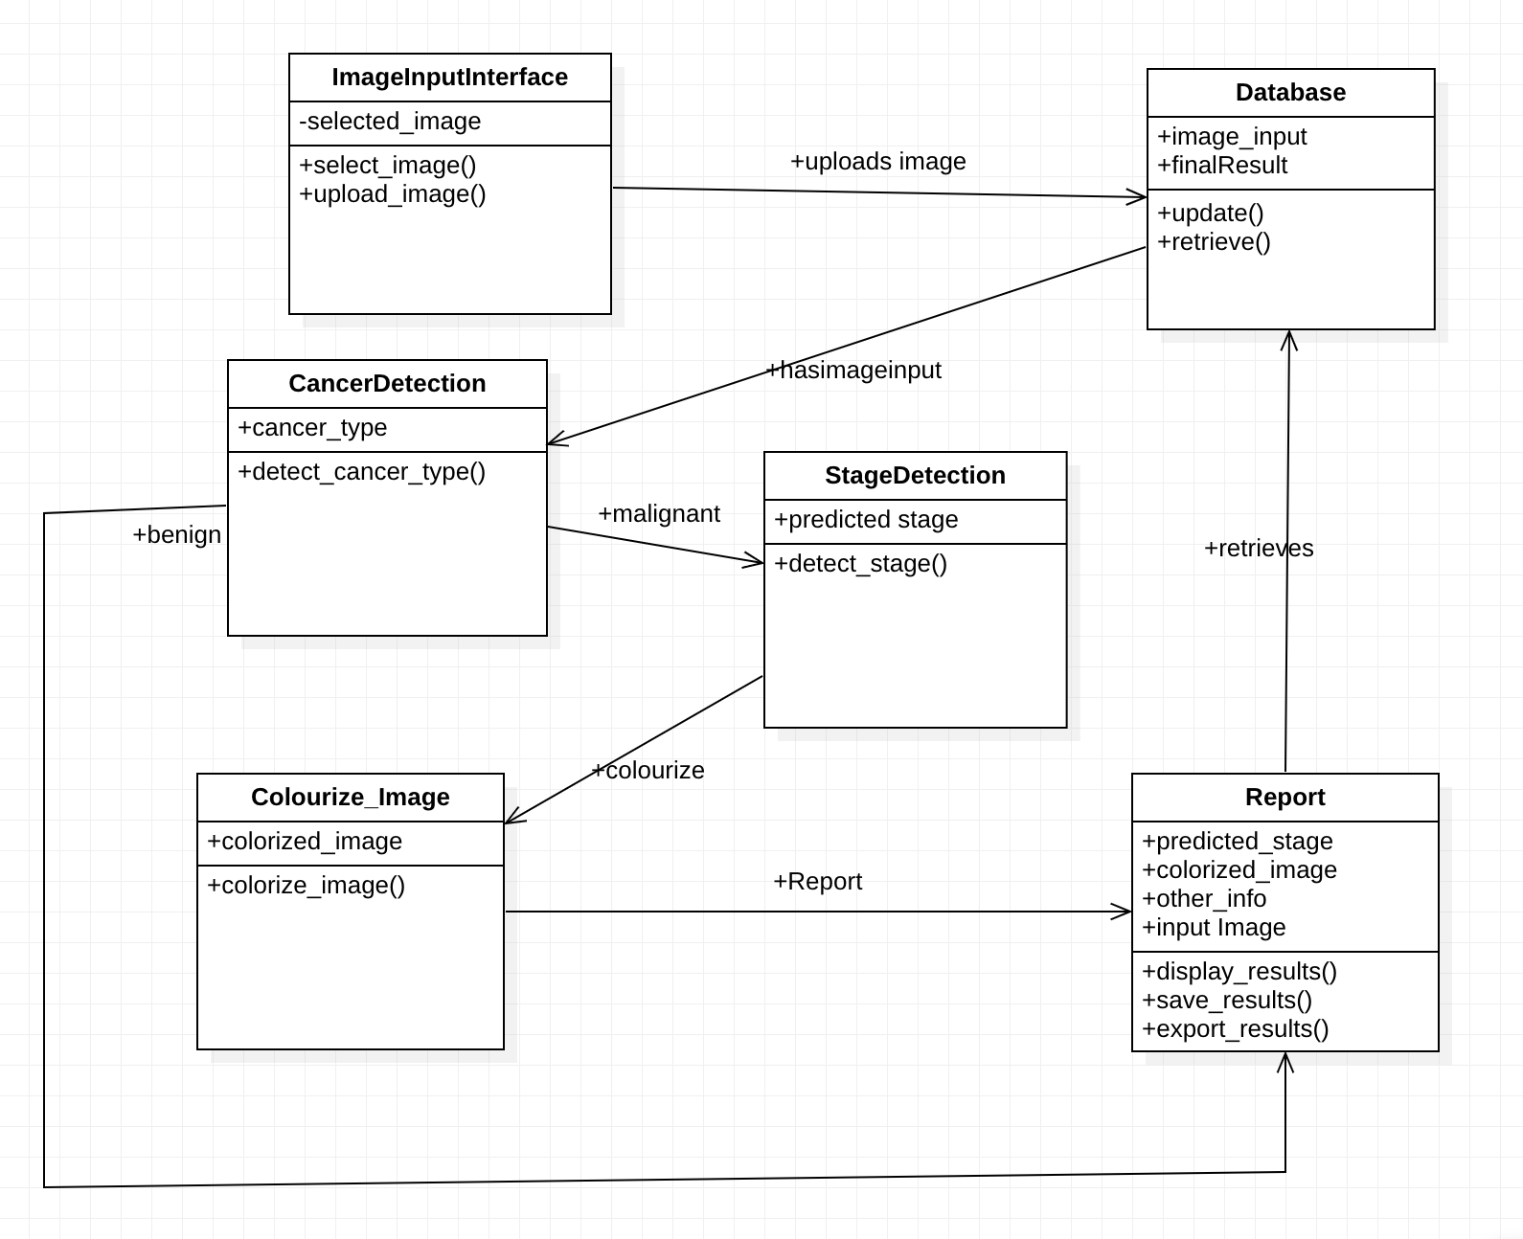
Master Class Diagram

Slide 33
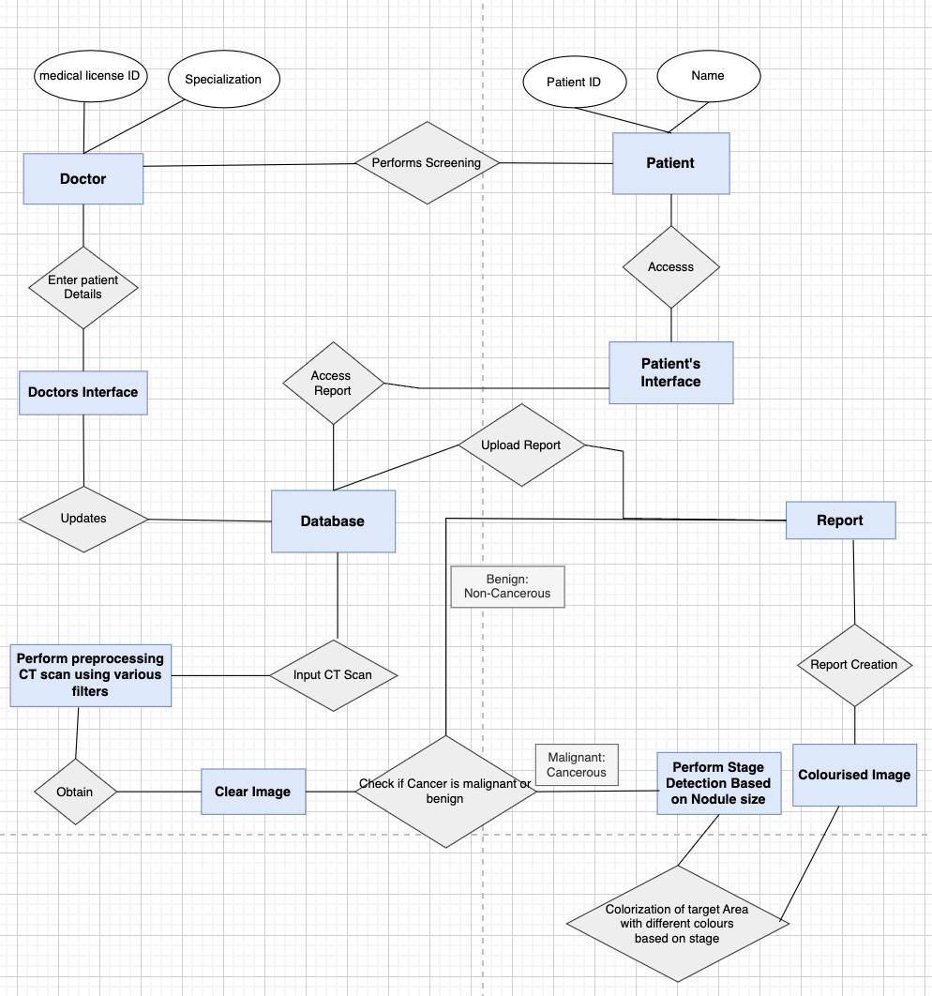
ER Diagram

Slide 34
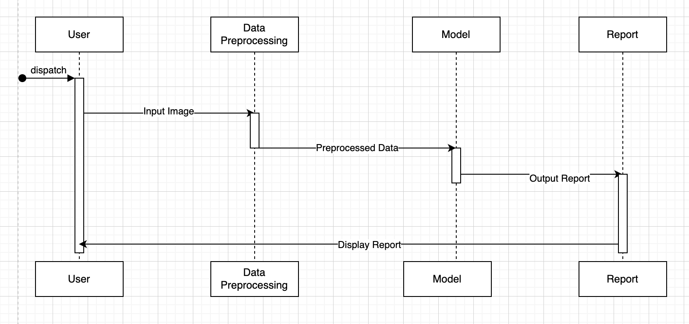
Sequence Diagram

Slide 35
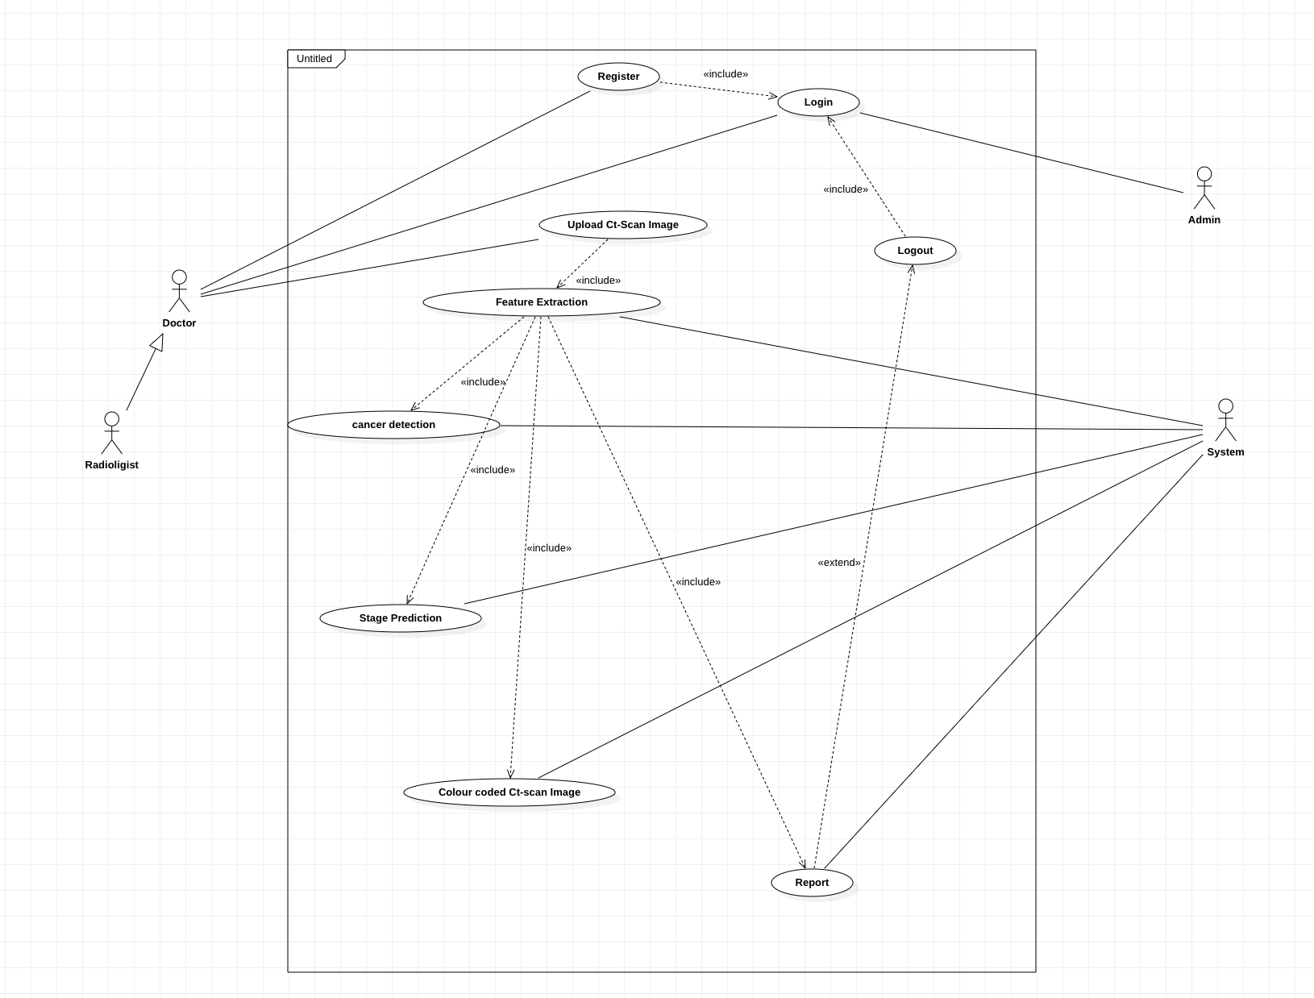
Use Case Diagram

Slide 36
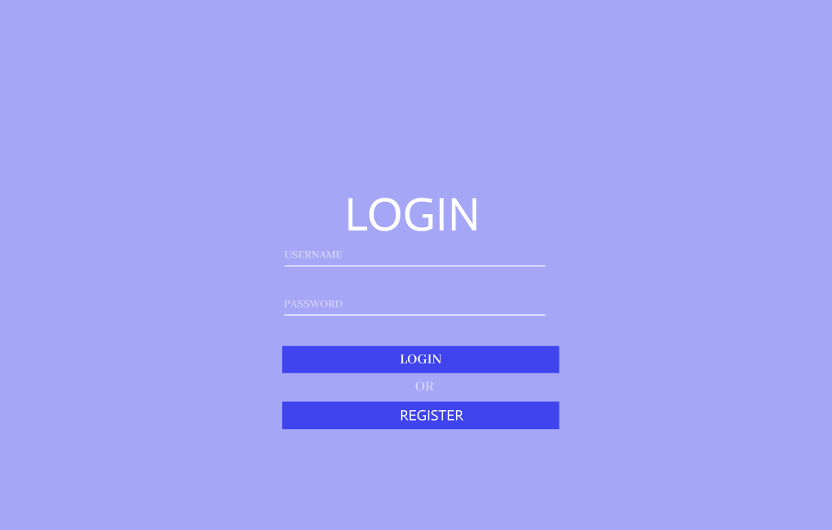
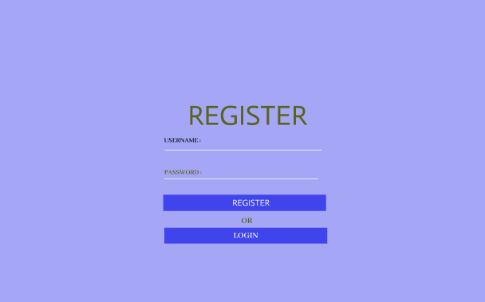
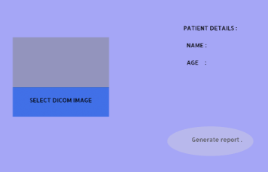
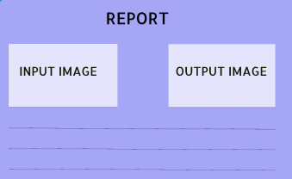
Interface

Slide 37
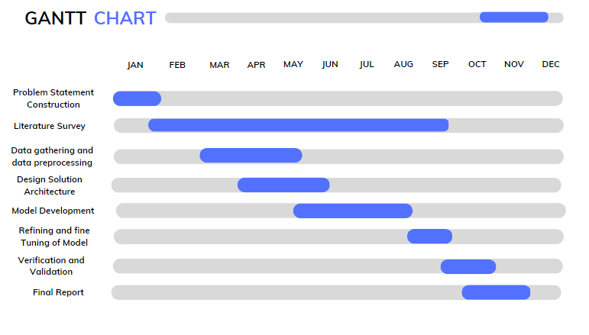
Capstone (Phase-I & Phase-II) Project Timeline

Slide 38
References
References pertaining to your research
[1] - S. S. Raoof, M. A. Jabbar, and S. A. Fathima, "Lung Cancer Prediction using Machine Learning: A Comprehensive Approach", in IEEE, 2020, DOI: 10.1109/ICACCE49856.2020.9074947
[2] - V. Deepa and P. Mohamed Fathimal, "Lung cancer prediction and Stage classification in CT Scans Using Convolution Neural Networks - A Deep learning Model", in IEEE, 2022, DOI: 10.1109/ICDSAAI55433.2022.10028880
[3] - Mohd Firdaus Abdullah; Muhammad Safwan Mansor; Siti Noraini Sulaiman, "A Comparative Study of Image Segmentation Technique applied for Lung Cancer Detection", in IEEE, 2019, DOI: 10.1109/ACCESS.2020.2993627

Slide 39
References
[5] - Adam Popowicz,Bogdan Smolka, “Isoline Based Image Colorization”, in IEEE, 2014, DOI 10.1109/UKSim.2014.27
[6]- Konstantinos Loverdos, Andreas Fotiadis, Chrysoula Kontogianni, Marianthi Iliopoulou, and Mina Gaga, “ Lung nodules: A comprehensive review on current approach and management” in IEEE, DOI: 10.4103/atm.ATM_110_19
[7]- S.A.D.L.V. Senarathna ,S.P.Y.A.A. Piyumal ,R. Hirshan,W.G.C.W. Kumara, “Lung Cancer Detection and Prediction of Cancer Stages Using Image Processing” in IEEE, 2021, DOI:
DOI: 10.1109/ICECIE52348.2021.9664658
[8]- B C Kavitha; K B Naveen, “Image Acquisition and Pre-processing for Detection of Lung Cancer using Neural Network” in IEEE, 2022, DOI: : 10.1109/ICERECT56837.2022.10060741

Slide 40
References
[9]- Gagan Thakral, Sapna Gambhir , Nagender Aneja, “Proposed methodology for Early Detection of Lung Cancer with low-dose CT Scan using Machine Learning” in IEEE, 2022, DOI: 10.1109/COM-IT-CON54601.2022.9850607
[10] - Janee Alam , Sabrina Alam , Alamgir Hossan , “Multi-Stage Lung Cancer Detection and Prediction Using Multi-class SVM Classifier” in IEEE, 2018,DOI: 10.1109/IC4ME2.2018.8465593

Slide 41
Thank You

